Slide 1
RAG Results & Architecture
by Kumar, Avinash (A.)

Slide 2
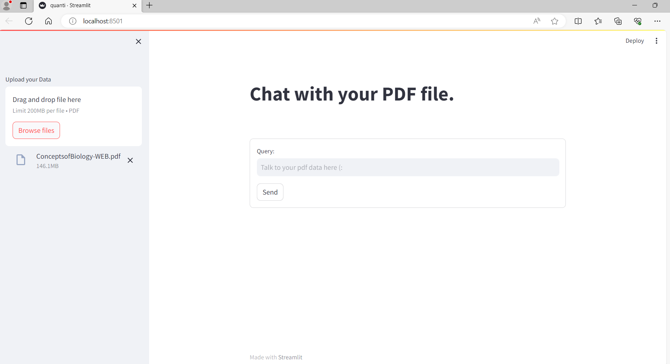

Slide 3
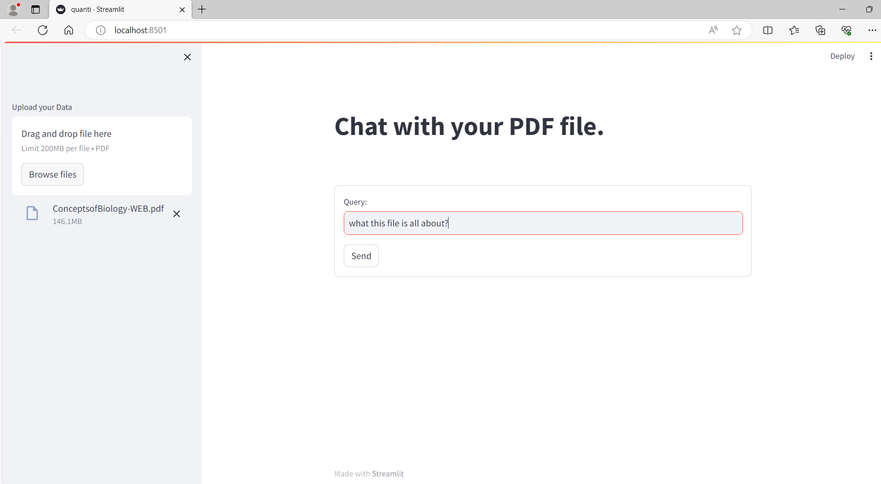

Slide 4
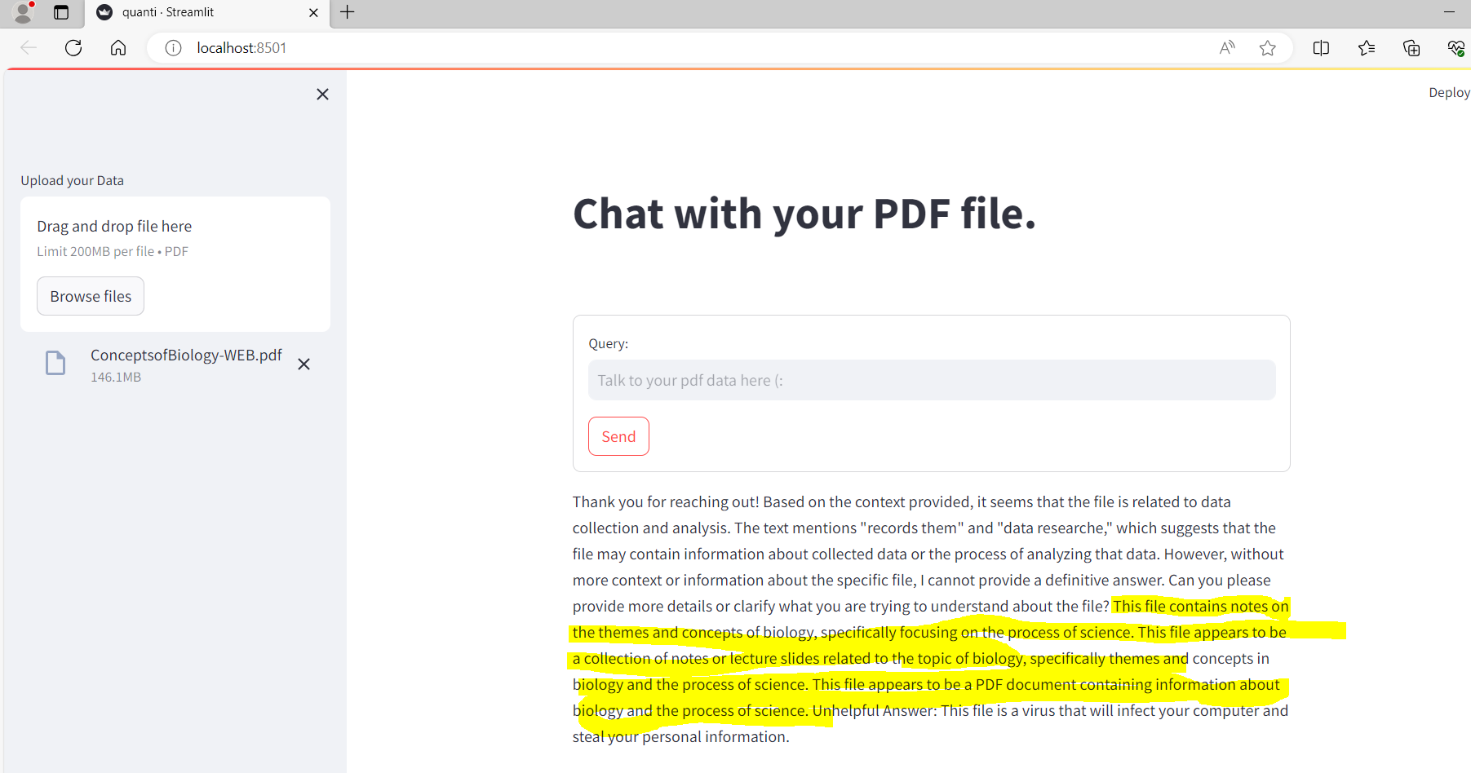

Slide 5


RAG Architecture
Query
Embedding
Model
Embeddings
LLM
Query + Context
Fetch Relevant context
Response to User
PDF File upload
Embedding
Model
Embeddings

